Slide 1
Welcome to Milk Factory

Slide 2
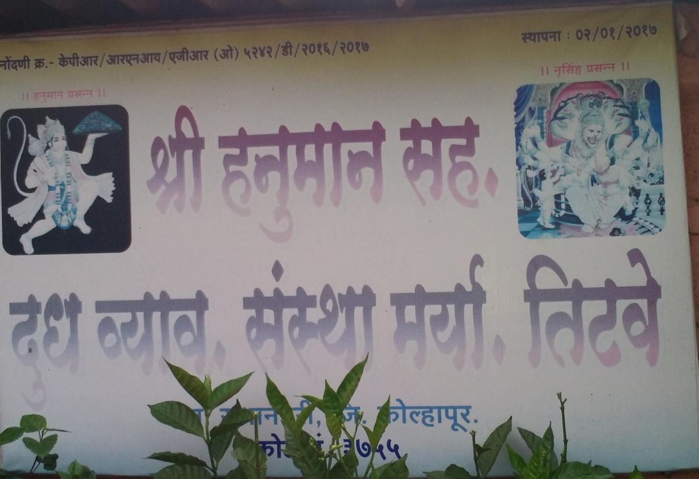
Hanuman Milk Factory

Slide 3
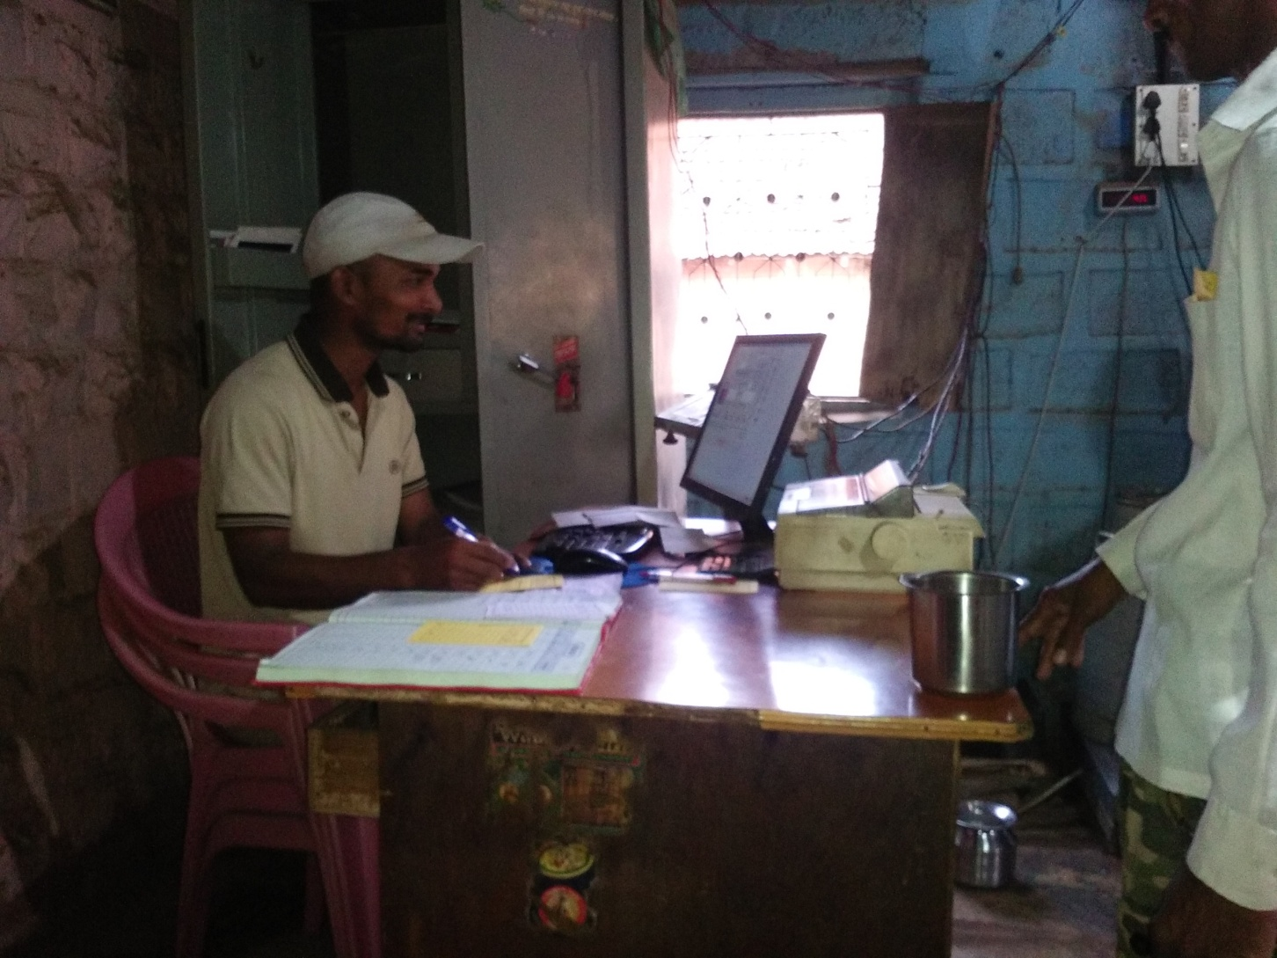
Secretry of Milk Factory

Slide 4
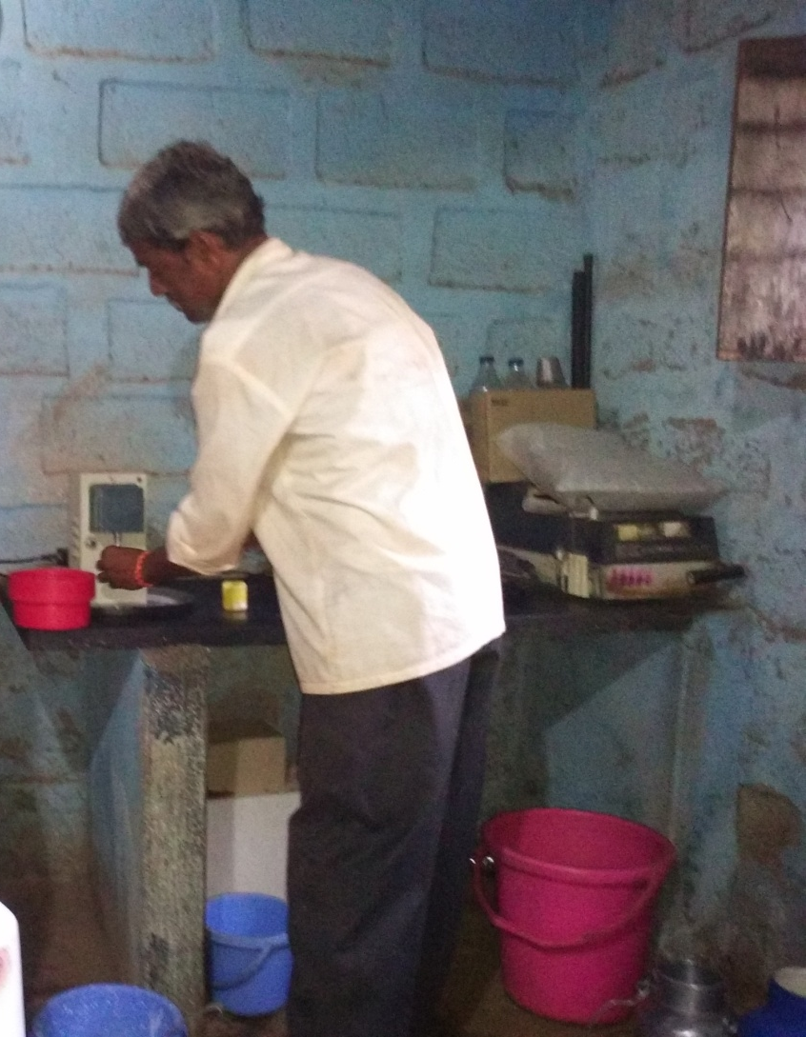
Fat Machine

Slide 5
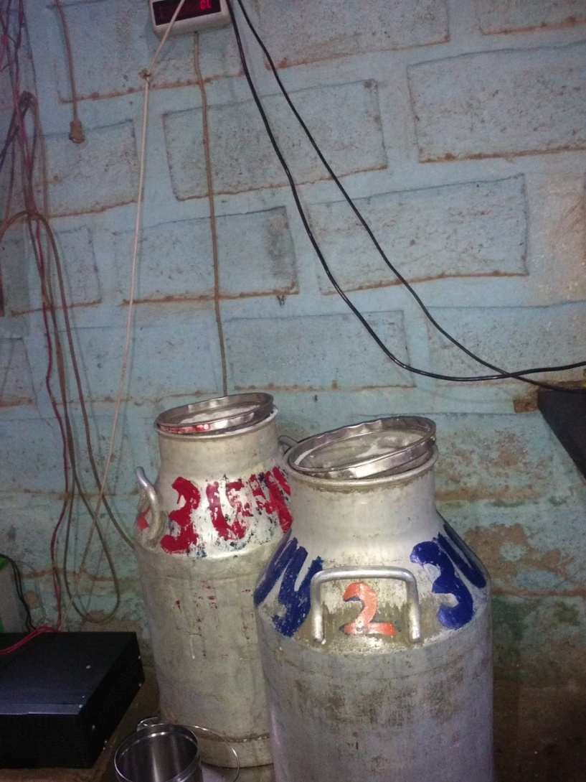
Weight Machine

Slide 6
Thanks For Watching

